Slide 1
128K x 8 CMOS Static RAM
Under the guidance of Dr. Kaushik Saha
Karthik M. B (2016EEY7523)
Souradeep Naskar (2016EEN2515)
Avinash Kumar (2016EEN2542)
Sumit Diware (2016JVL2111)
Sharath B. K (2016JVL2109)

Slide 2
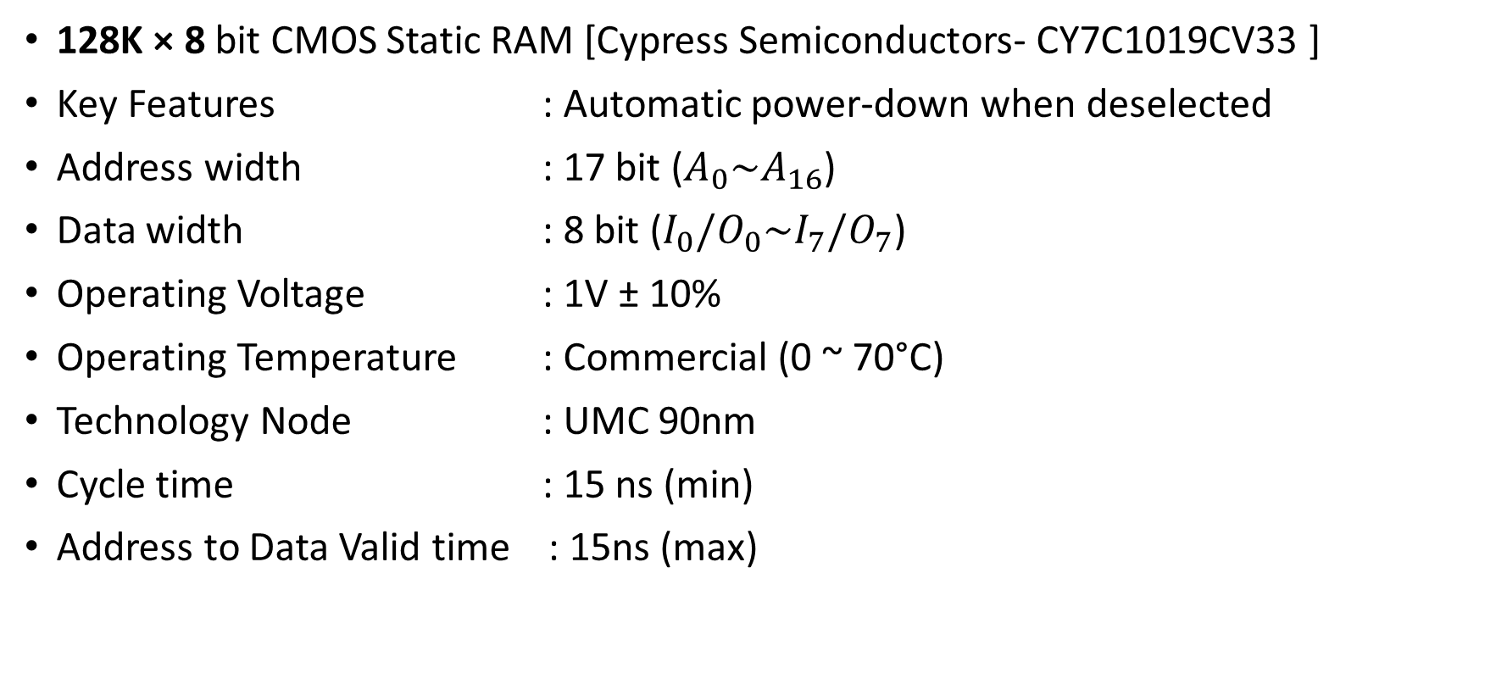
Targeted Specifications
128K × 8 bit CMOS Static RAM [Cypress Semiconductors- CY7C1019CV33 ]
Key Features : Automatic power-down when deselected
Address width : 17 bit ($A_{0}\sim A_{16}$)
Data width : 8 bit (${I_{0}/O}_{0}\sim {I_{7}/O}_{7}$)
Operating Voltage : 1V ± 10%
Operating Temperature : Commercial (0 ~ 70°C)
Technology Node : UMC 90nm
Cycle time : 15 ns (min)
Address to Data Valid time : 15ns (max)

Slide 3
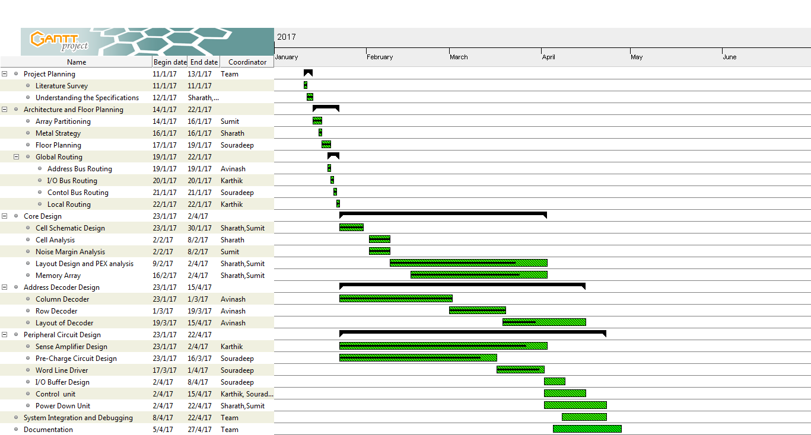
Gantt Chart

Slide 4
Array Partitioning
We have 17 address lines => 2¹⁷ Memory locations of 8 bit each
i.e. 2²⁰ bits.
To get a square array we choose 2¹⁰ bit lines and 2¹⁰ word line.
Since our package pin configuration is symmetric , to facilitate routing we chose quadrant alignment of the cores.
i.e. 4 banks of 32k x 8bits

Slide 5
However for improving speed we prefer smaller bank size to have smaller word line and bit line capacitances.
Therefore we opt for 8 banks of 16k x 8bits each .
But the decoder logic complexity increases exponentially as the number of banks increases and hence we don’t choose banks of smaller size.

Slide 6
Metal Planning
Layers | Application | Resistance( Ω/μm) | Capacitance( aF/μm)
Metal Layer 1 | Local Routing | 0.865 | 88.09
Metal Layer 2 | Word Line Strapping | 0.727 | 70.96
Metal Layer 3 | Bit Line | 0.727 | 62.43
Metal Layer 4 | Bit Line Complement | 0.727 | 57.83
Metal Layer 5 | Address Routing | 0.727 | 54.99
Metal Layer 6 | Control Routing | 0.727 | 54.78
Metal Layer 7 | VSS | 0.159 | 71.11
Metal Layer 8 | VDD | 0.161 | 67.57

Slide 7
Address Lines Division
No. of Row Decoding Bits = 5 (A0 – A4)
No. of Column Decoding Bits = 9 (A5 – A13)
No. of Bits for bank Selection = 3 (A14 – A16)

Slide 8
Floor Planning and Routing

Slide 9
A₀
A₁₆
I
/O
BUFFERS
16K × 8 bit
SRAM Core
16K × 8 bit
SRAM Core
I
/O
BUFFERS
A₁
ROW DECODER
WRITE BUFFER
ROW DECODER
A₁₅
PRECHARGE
SENSE AMPLIFIER
PRECHARGE
SENSE AMPLIFIER
A₂
A₁₄
A₃
COLUMN DECODER
COLUMN DECODER
COLUMN DECODER
COLUMN DECODER
A₁₃
16K × 8 bit
SRAM Core
ROW DECODER
WRITE BUFFER
ROW DECODER
16K × 8 bit
SRAM Core
I/O₀
PRECHARGE
SENSE AMPLIFIER
PRECHARGE
SENSE AMPLIFIER
I/O₇
I/O₁
I/O₆
V_{CC}
V_{SS}
TIMING AND CONTROL CIRCUIT
ADDRESS TRANSITION DETECTOR
BLOCK DECODER
V_{SS}
V_{CC}
I/O₂
I/O₅
I/O₃
16K × 8 bit
SRAM Core
16K × 8 bit
SRAM Core
I/O₄
SENSE AMPLIFIER
ROW DECODER
WRITE BUFFER
ROW DECODER
SENSE AMPLIFIER
PRECHARGE
PRECHARGE
A₁₂
A₄
A₁₁
COLUMN DECODER
COLUMN DECODER
COLUMN DECODER
COLUMN DECODER
A₅
A₁₀
A₆
16K × 8 bit
SRAM Core
ROW DECODER
WRITE BUFFER
ROW DECODER
16K × 8 bit
SRAM Core
A₉
PRECHARGE
SENSE AMPLIFIER
PRECHARGE
SENSE AMPLIFIER
A₇
A₈

Slide 10
A₀
A₁₆
I
/O
BUFFERS
16K × 8 bit
SRAM Core
16K × 8 bit
SRAM Core
I
/O
BUFFERS
A₁
ROW DECODER
WRITE BUFFER
ROW DECODER
A₁₅
PRECHARGE
SENSE AMPLIFIER
PRECHARGE
SENSE AMPLIFIER
A₂
A₁₄
A₃
COLUMN DECODER
COLUMN DECODER
COLUMN DECODER
COLUMN DECODER
A₁₃
16K × 8 bit
SRAM Core
ROW DECODER
WRITE BUFFER
ROW DECODER
16K × 8 bit
SRAM Core
I/O₀
PRECHARGE
SENSE AMPLIFIER
PRECHARGE
SENSE AMPLIFIER
I/O₇
I/O₁
I/O₆
V_{CC}
V_{SS}
TIMING AND CONTROL CIRCUIT
ADDRESS TRANSITION DETECTOR
BLOCK DECODER
V_{SS}
V_{CC}
I/O₂
I/O₅
I/O₃
16K × 8 bit
SRAM Core
16K × 8 bit
SRAM Core
I/O₄
SENSE AMPLIFIER
ROW DECODER
WRITE BUFFER
ROW DECODER
SENSE AMPLIFIER
PRECHARGE
PRECHARGE
A₁₂
A₄
A₁₁
COLUMN DECODER
COLUMN DECODER
COLUMN DECODER
COLUMN DECODER
A₅
A₁₀
A₆
16K × 8 bit
SRAM Core
ROW DECODER
WRITE BUFFER
ROW DECODER
16K × 8 bit
SRAM Core
A₉
PRECHARGE
SENSE AMPLIFIER
PRECHARGE
SENSE AMPLIFIER
A₇
A₈

Slide 11
A₀
A₁₆
I
/O
BUFFERS
16K × 8 bit
SRAM Core
16K × 8 bit
SRAM Core
I
/O
BUFFERS
A₁
ROW DECODER
WRITE BUFFER
ROW DECODER
A₁₅
PRECHARGE
SENSE AMPLIFIER
PRECHARGE
SENSE AMPLIFIER
A₂
A₁₄
A₃
COLUMN DECODER
COLUMN DECODER
COLUMN DECODER
COLUMN DECODER
A₁₃
16K × 8 bit
SRAM Core
ROW DECODER
WRITE BUFFER
ROW DECODER
16K × 8 bit
SRAM Core
I/O₀
PRECHARGE
SENSE AMPLIFIER
PRECHARGE
SENSE AMPLIFIER
I/O₇
I/O₁
I/O₆
V_{CC}
V_{SS}
TIMING AND CONTROL CIRCUIT
ADDRESS TRANSITION DETECTOR
BLOCK DECODER
V_{SS}
V_{CC}
I/O₂
I/O₅
I/O₃
16K × 8 bit
SRAM Core
16K × 8 bit
SRAM Core
I/O₄
SENSE AMPLIFIER
ROW DECODER
WRITE BUFFER
ROW DECODER
SENSE AMPLIFIER
PRECHARGE
PRECHARGE
A₁₂
A₄
A₁₁
COLUMN DECODER
COLUMN DECODER
COLUMN DECODER
COLUMN DECODER
A₅
A₁₀
A₆
16K × 8 bit
SRAM Core
ROW DECODER
WRITE BUFFER
ROW DECODER
16K × 8 bit
SRAM Core
A₉
PRECHARGE
SENSE AMPLIFIER
PRECHARGE
SENSE AMPLIFIER
A₇
A₈

Slide 12
Comparison of various SRAM Cell Architectures
Parameters | 6T SRAM | 7T SRAM | 8T SRAM | 9T SRAM | 10T SRAM
Read Margin (mV) | 156 | 156 | 330 | 330 | 176
Write Margin (mV) | 551 | 796 | 598 | 598 | 423
Size | X | 1.48X | 1.24X | 1.95X | 2.78X
Read Delay (psec) | 555 | 842 | 731 | 755 | 555
Write Delay (psec) | 50.6 | 39.1 | 38.3 | 41.4 | 79.3
Leakage Power (nW) | 242 | 250 | 322 | 331 | 488
Ref : Binh-Son LE, Thanh-Tri VO, “SRAM Cell for High Noise Margin & Soft Errors Tolerance in Nanoscale Technology”, IEEE 2014

Slide 13
Advantages of 6T Cell
Lower power dissipation - 6T SRAM cell has less leakage current because less number of transistors are being used compared to 7T, 8T, 9T SRAM cell architecture.
Good stability - 6T SRAM cell has good stability as compared to 4T SRAM cell.
As 4T SRAM cell has lower value of SNM (Static Noise Margin), high standby
current and is not as fast as the 6T cell.
Symmetric structure - Helps during fabrication of device.

Slide 14
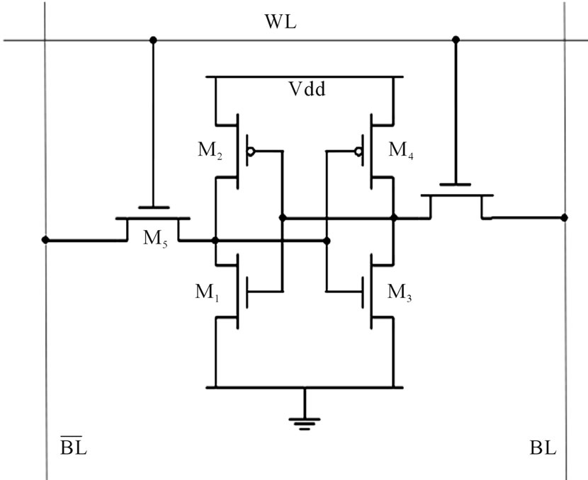
6T SRAM Cell
M₁ M₃ : Pull down transistors.
M₂ M₄ : Pull up transistors.
M₅ M₆ : Access transistors
M6
For Read Stability : M1,M3 pull down transistors should be stronger than the M5,M6 access transistors
For Write Stability : M2,M4 pull up transistors should be weaker than the M5,M6 access transistors
Basic SRAM cell

Slide 15
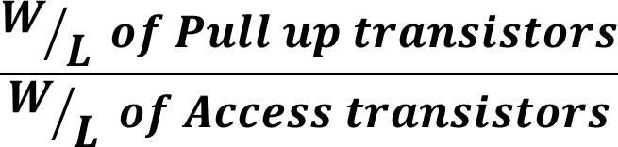
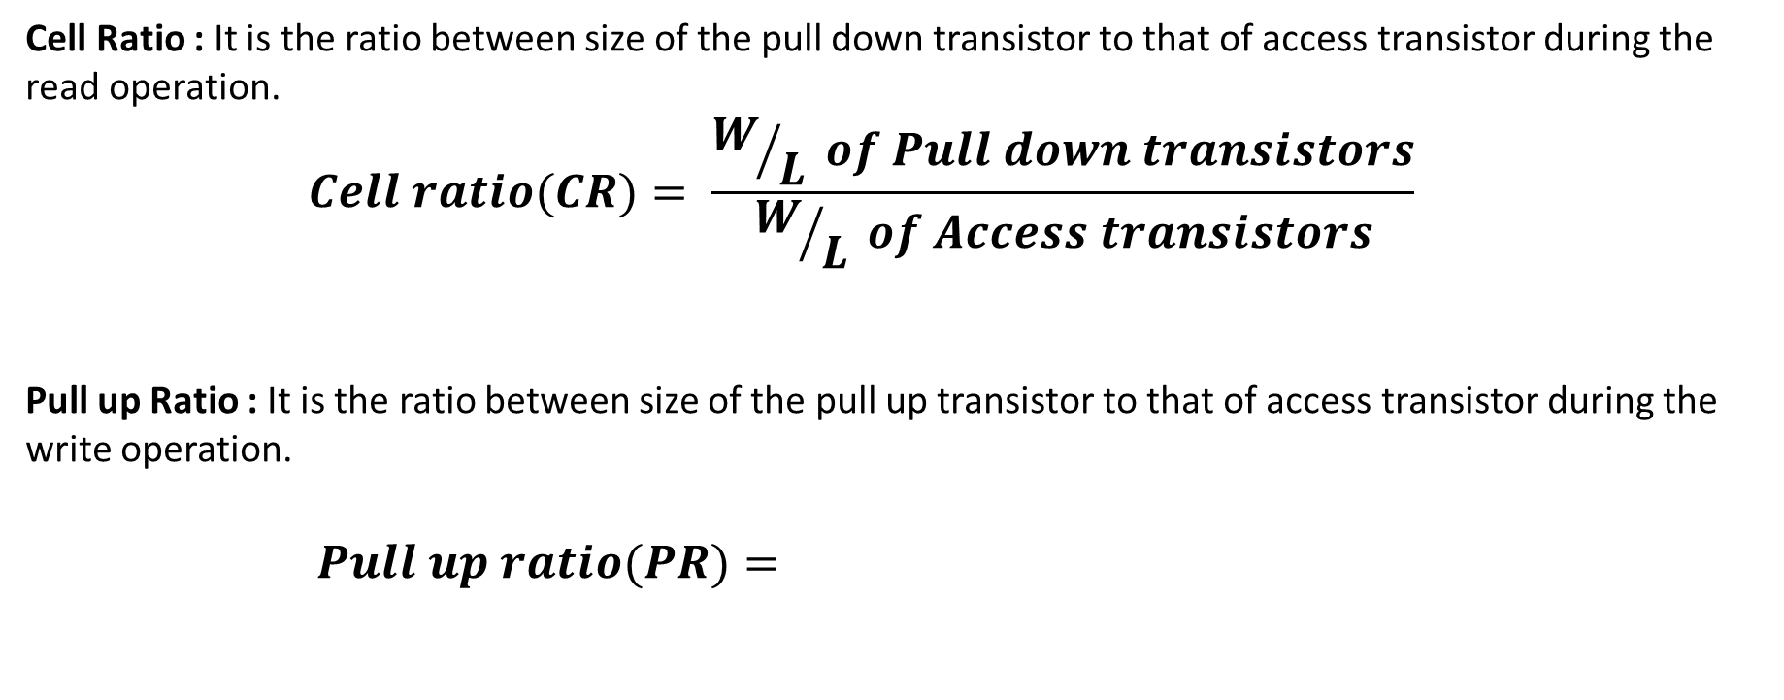
Cell Ratio and Pull-up Ratio
Cell Ratio : It is the ratio between size of the pull down transistor to that of access transistor during the read operation.
$$Cell ratio(CR)= \frac{W/L of Pull down transistors}{W/L of Access transistors}$$
Pull up Ratio : It is the ratio between size of the pull up transistor to that of access transistor during the write operation.
$Pull up ratio(PR)=$

Slide 16
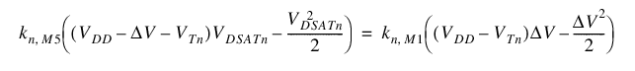
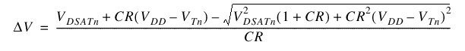
CMOS SRAM Analysis (Read)
WL
V
DD
BL
M
4
BL
Q
=
0
Q
=
1
M
6
M
5
V
DD
M
1
V
DD
V
DD
C
bit
C
bit

Slide 17
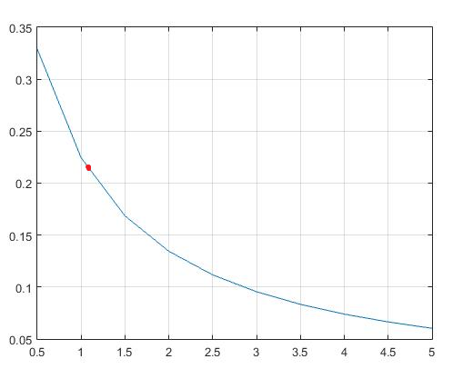
CMOS SRAM Analysis (Read)
CR(min)
1.1
Voltage Rise (V)
Cell Ratio

Slide 18
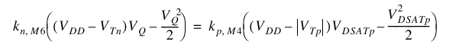
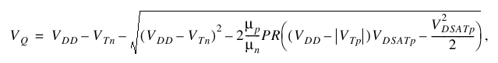
CMOS SRAM Analysis (Write)
WL
V
DD
M
4
Q
=
0
M
6
M
5
Q
=
1
M
1
V
DD
BL
=
1
BL
=
0

Slide 19
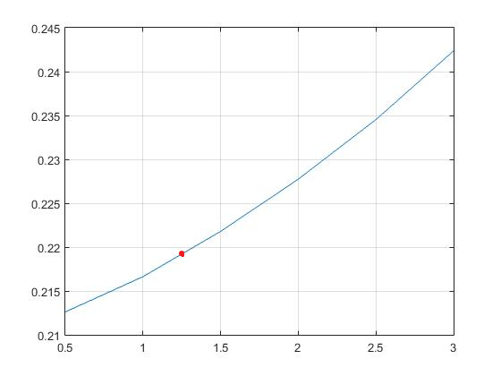
CMOS SRAM Analysis (Write)
PR(max)
1.25
Cell Voltage (V)
Pull Up Ratio

Slide 20
Static Noise Margins
The static noise margin (SNM) measures how much noise can be applied to the inputs of the two cross-coupled inverters before a stable state is lost (during hold or read) or a second stable state is created (during write).
Acceptable value of SNM are used to decide the optimum values of CR, PR.
Cadence Virtuoso was used for circuit simulation and the corresponding Butterfly curves were plotted using MATLAB.
Ref : 1. EVERT SEEVINCK, FRANS J. LIST, AND JAN LOHSTROH, M “Static-Noise Margin Analysis of MOS SRAM Cells”, IEEE 1987
2. CMOS VLSI Design: A Circuits and Textbook by David Harris and Neil Weste

Slide 21
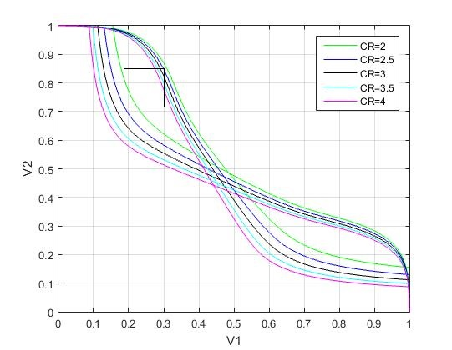
Read Static Noise Margins
CR | SNM (V)
2 | 0.141
2.5 | 0.155
3 | 0.169
3.5 | 0.184
4 | 0.198

Slide 22
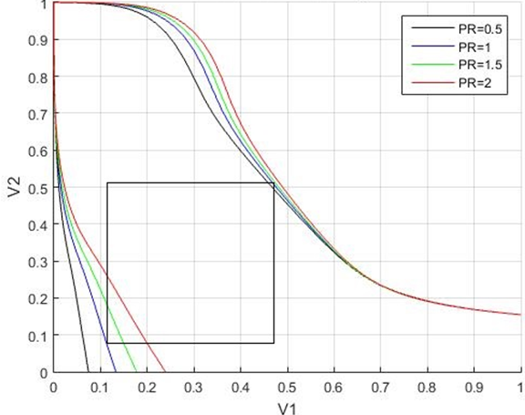
Write Static Noise Margins
PR | SNM (V)
1 | 0.523

Slide 23
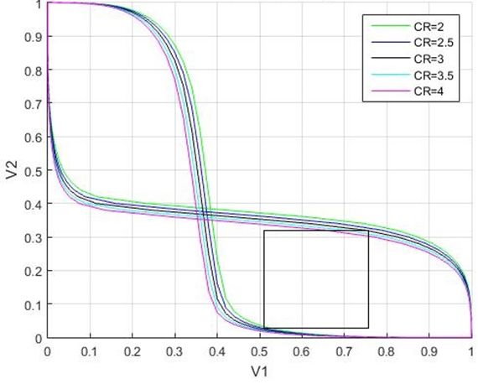
Hold Static Noise Margins
CR | SNM (V)
2 | 0.318

Slide 24
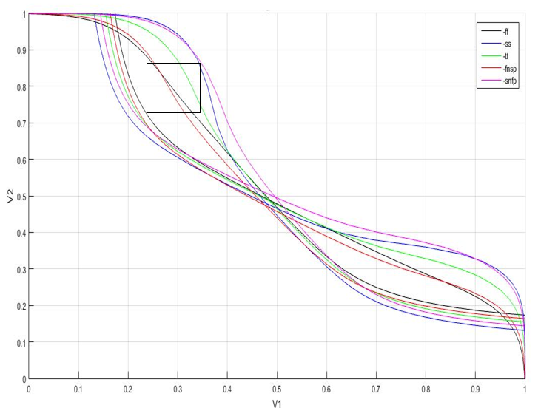
Read Static Noise Margins around Process Corners
Corner | SNM (V)
SS | 0.163

Slide 25
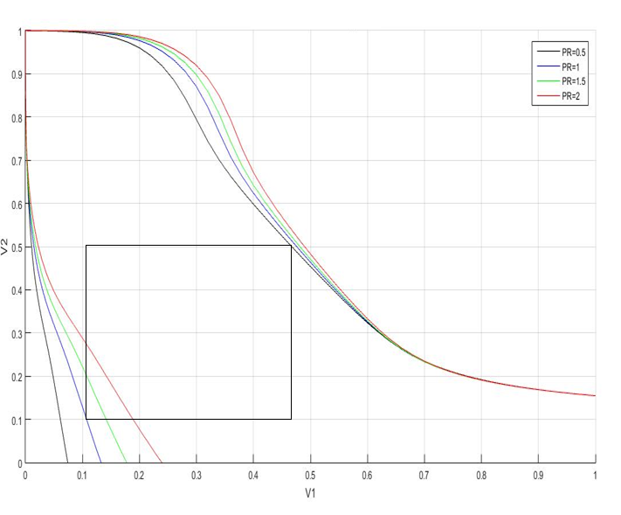
Write Static Noise Margins around Process Corners
Corner | SNM (V)
SS | 0.509

Slide 26
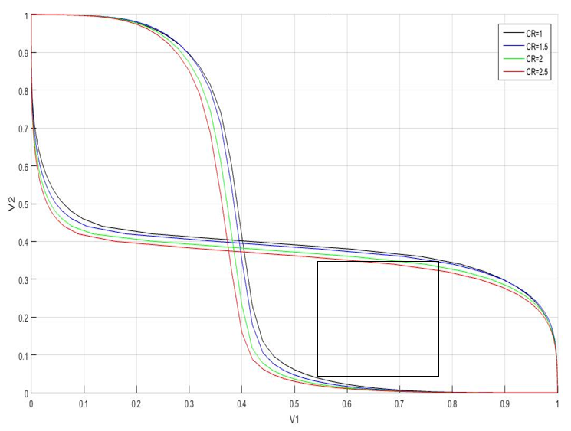
Hold Static Noise Margins around Process Corners
Corner | SNM (V)
SS | 0.3536

Slide 27
Bitline Twisting
Bit line twisting will make sure that effect of coupling noise will be symmetric on both BL and BL_BAR, and thus effect of coupling noise will be reduced.
Bit line twisting scheme, where bit line is twisted after every 16 columns (or after every 16th Word Line).
There are total 512 columns. Bit line is twisted 32 times in each core.

Slide 28
SRAM Cell Sizing:
The access transistors were chosen to be of minimum size so as to minimize the bitline capacitance.
Considering acceptable noise margins pull-up ratio was chosen to be 1 and cell ratio was 2.
Optimum CR = 2 & PR = 1.0
Sizing of Transistors : L= 80 nm
Pull-up Transistors : W = 120 nm
Access Transistors : W = 120 nm
Drive Transistors : W = 240 nm
Process Corner : Slow NMOS Slow PMOS (ss)

Slide 29
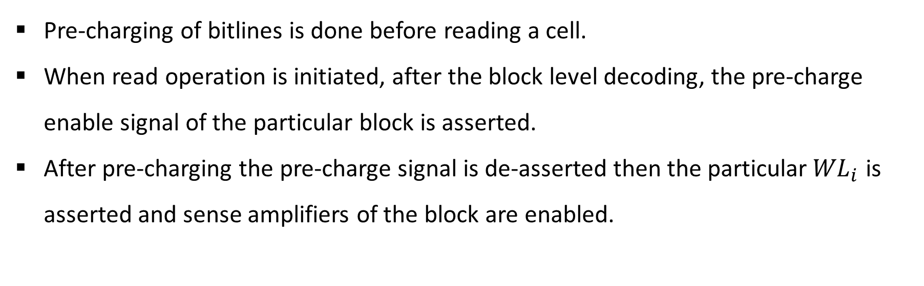
Pre-charge Scheme
Pre-charging of bitlines is done before reading a cell.
When read operation is initiated, after the block level decoding, the pre-charge enable signal of the particular block is asserted.
After pre-charging the pre-charge signal is de-asserted then the particular${WL}_{i}$ is asserted and sense amplifiers of the block are enabled.

Slide 30
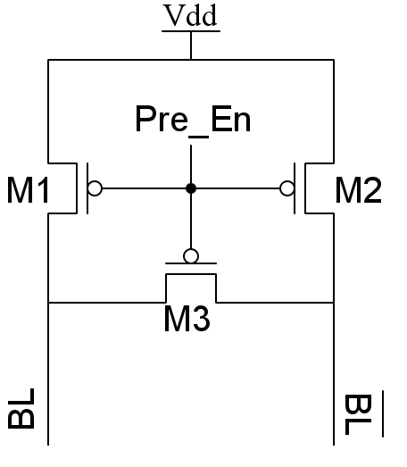
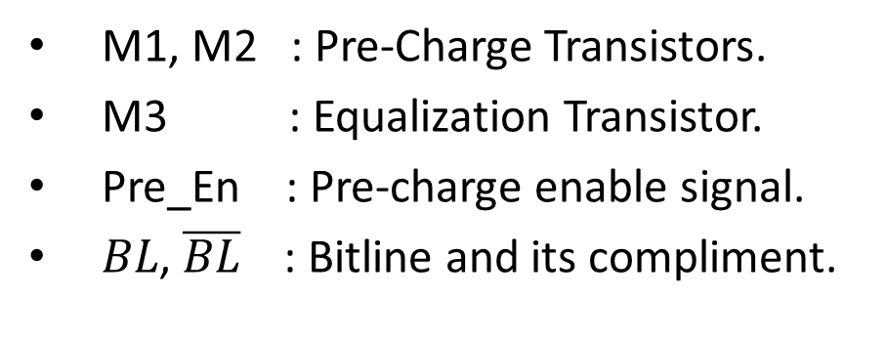
Pre-charge Circuit
M1, M2 : Pre-Charge Transistors.
M3 : Equalization Transistor.
Pre_En : Pre-charge enable signal.
$BL$, $\overline{BL}$ : Bitline and its compliment.

Slide 31
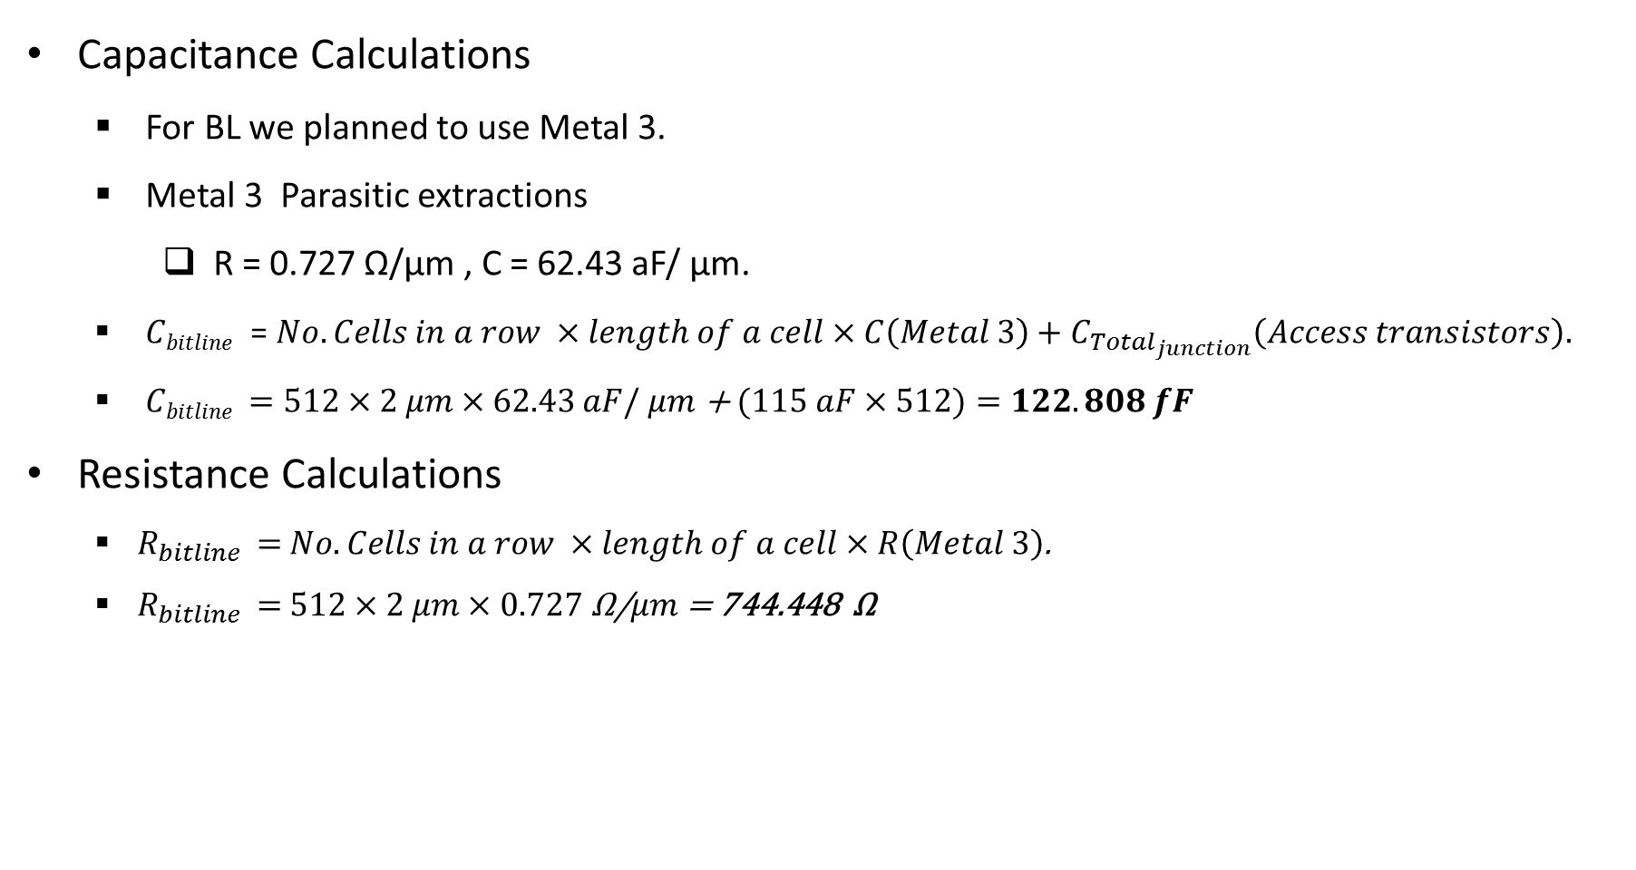
Calculations of bitline transients
Capacitance Calculations
For BL we planned to use Metal 3.
Metal 3 Parasitic extractions
R = 0.727 Ω/μm , C = 62.43 aF/ μm.
$Cbitline$ = $No. Cells in a row ×length of a cell×C\left(Metal 3\right)+C_{Total_{junction}}\left(Access transistors\right).$
$Cbitline$ $=512×2$ $μm×62.43$ $aF/ μm$ + $(115 aF×512)=122.808 fF$
Resistance Calculations
$R_{bitline }=$ $No. Cells in a row ×length of a cell×R\left(Metal 3\right)$.
$R_{bitline }=$ $512×2 μm×0.727 \text{Ω}\text{/}μm$ = 744.448 $\text{Ω}$

Slide 32
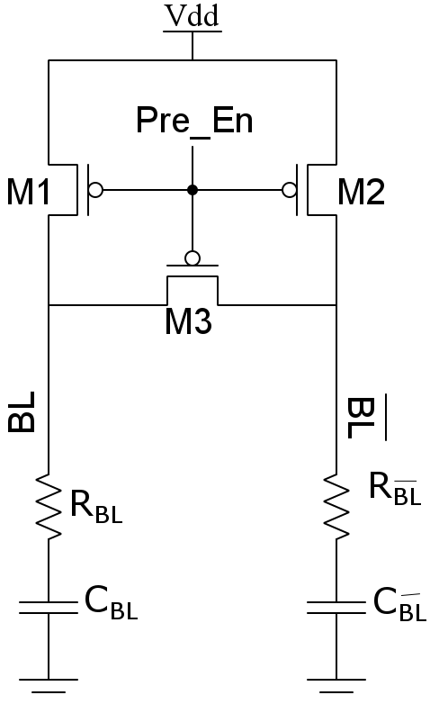
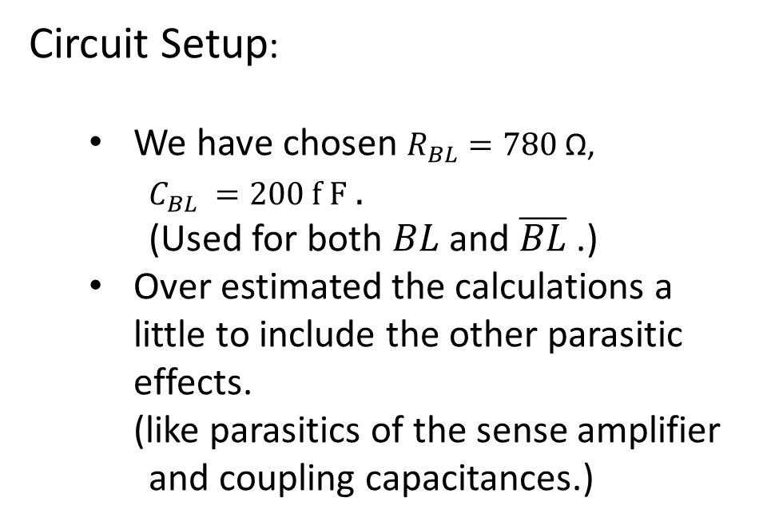
Bitline pre-charge settling analysis
Circuit Setup:
We have chosen $R_{BL}=780 \text{Ω}\text{, }$
$C_{BL} =200 f F$ .
(Used for both $BL$ and $\overline{BL}$ .)
Over estimated the calculations a little to include the other parasitic effects.
(like parasitics of the sense amplifier and coupling capacitances.)

Slide 33
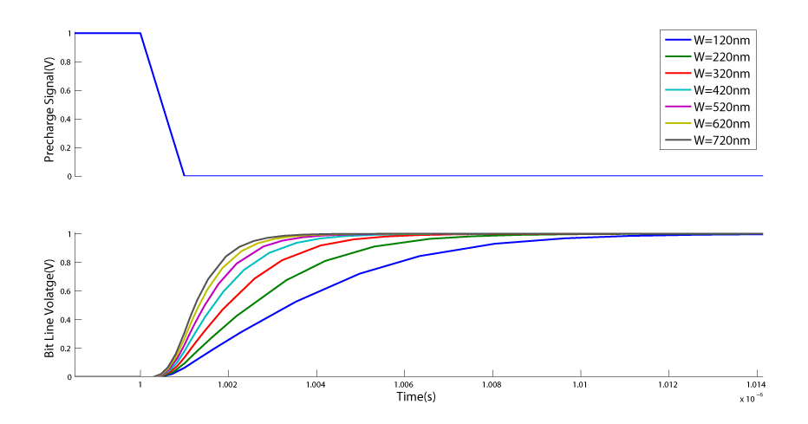
Pre-charge Settling Time Analysis

Slide 34
Width of Pre-charge Transistors(nm) | 90% Settling Time(ns)
120 | 7.49
220 | 5.21
320 | 3.95
420 | 3.20
520 | 2.75
620 | 2.66
720 | 2.57

Slide 35
Address Lines Division
No. of Row Decoding Bits = 5 (A0 – A4)
No. of Column Decoding Bits = 9 (A5 – A13)
No. of Bits for bank Selection = 3 (A14 – A16)

Slide 36
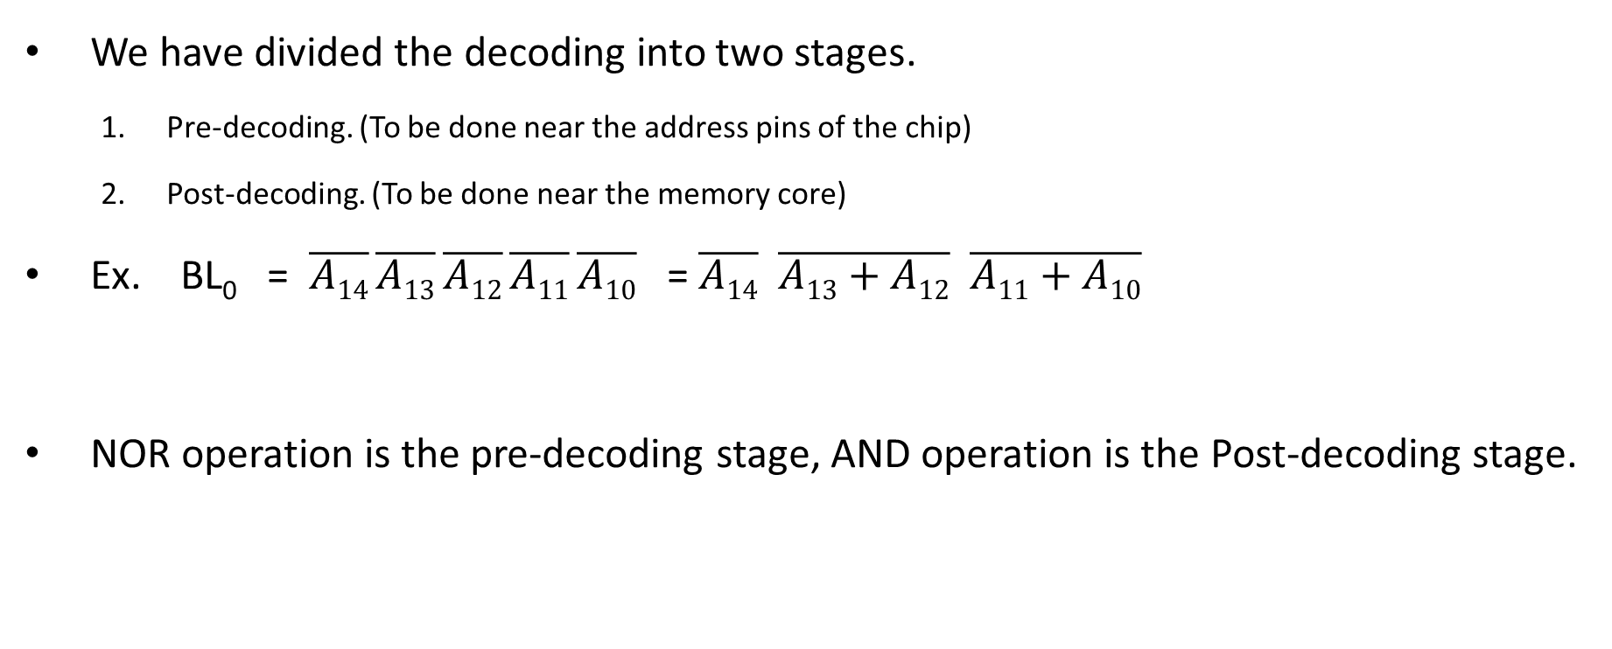
Decoder Design Strategy
We have divided the decoding into two stages.
Pre-decoding. (To be done near the address pins of the chip)
Post-decoding. (To be done near the memory core)
Ex. BL₀ = $\overline{A14}$ $\overline{A13}$ $\overline{A12}$ $\overline{A11}$ $\overline{A10}$ = $\overline{A14}$ $\overline{A13+A12} \overline{A11+A10}$
NOR operation is the pre-decoding stage, AND operation is the Post-decoding stage.

Slide 37
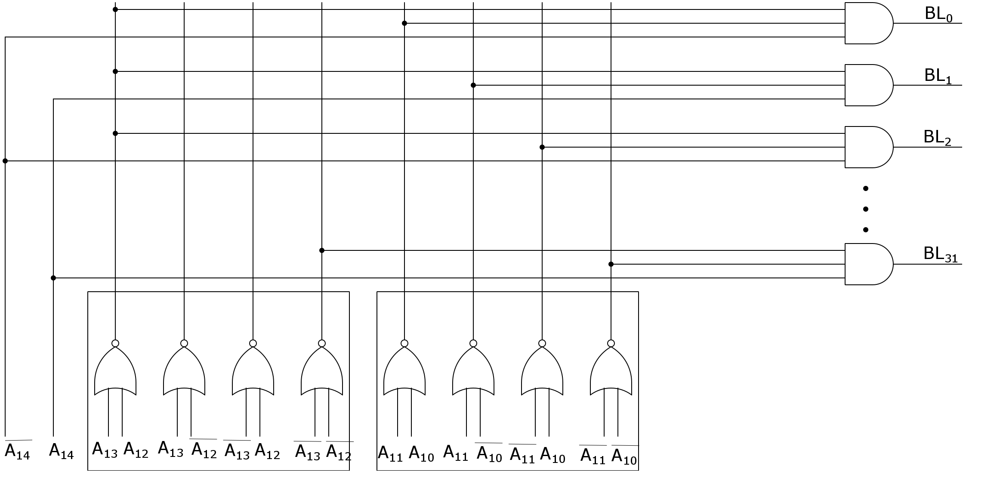
Row Decoder circuit
Post-Decoding
Pre-Decoding

Slide 38
Another Decoder strategy
To reduce the decoder delay we distributed the pre-decoding part in multiple stages.
It reduces the delay and transistor count.

Slide 39
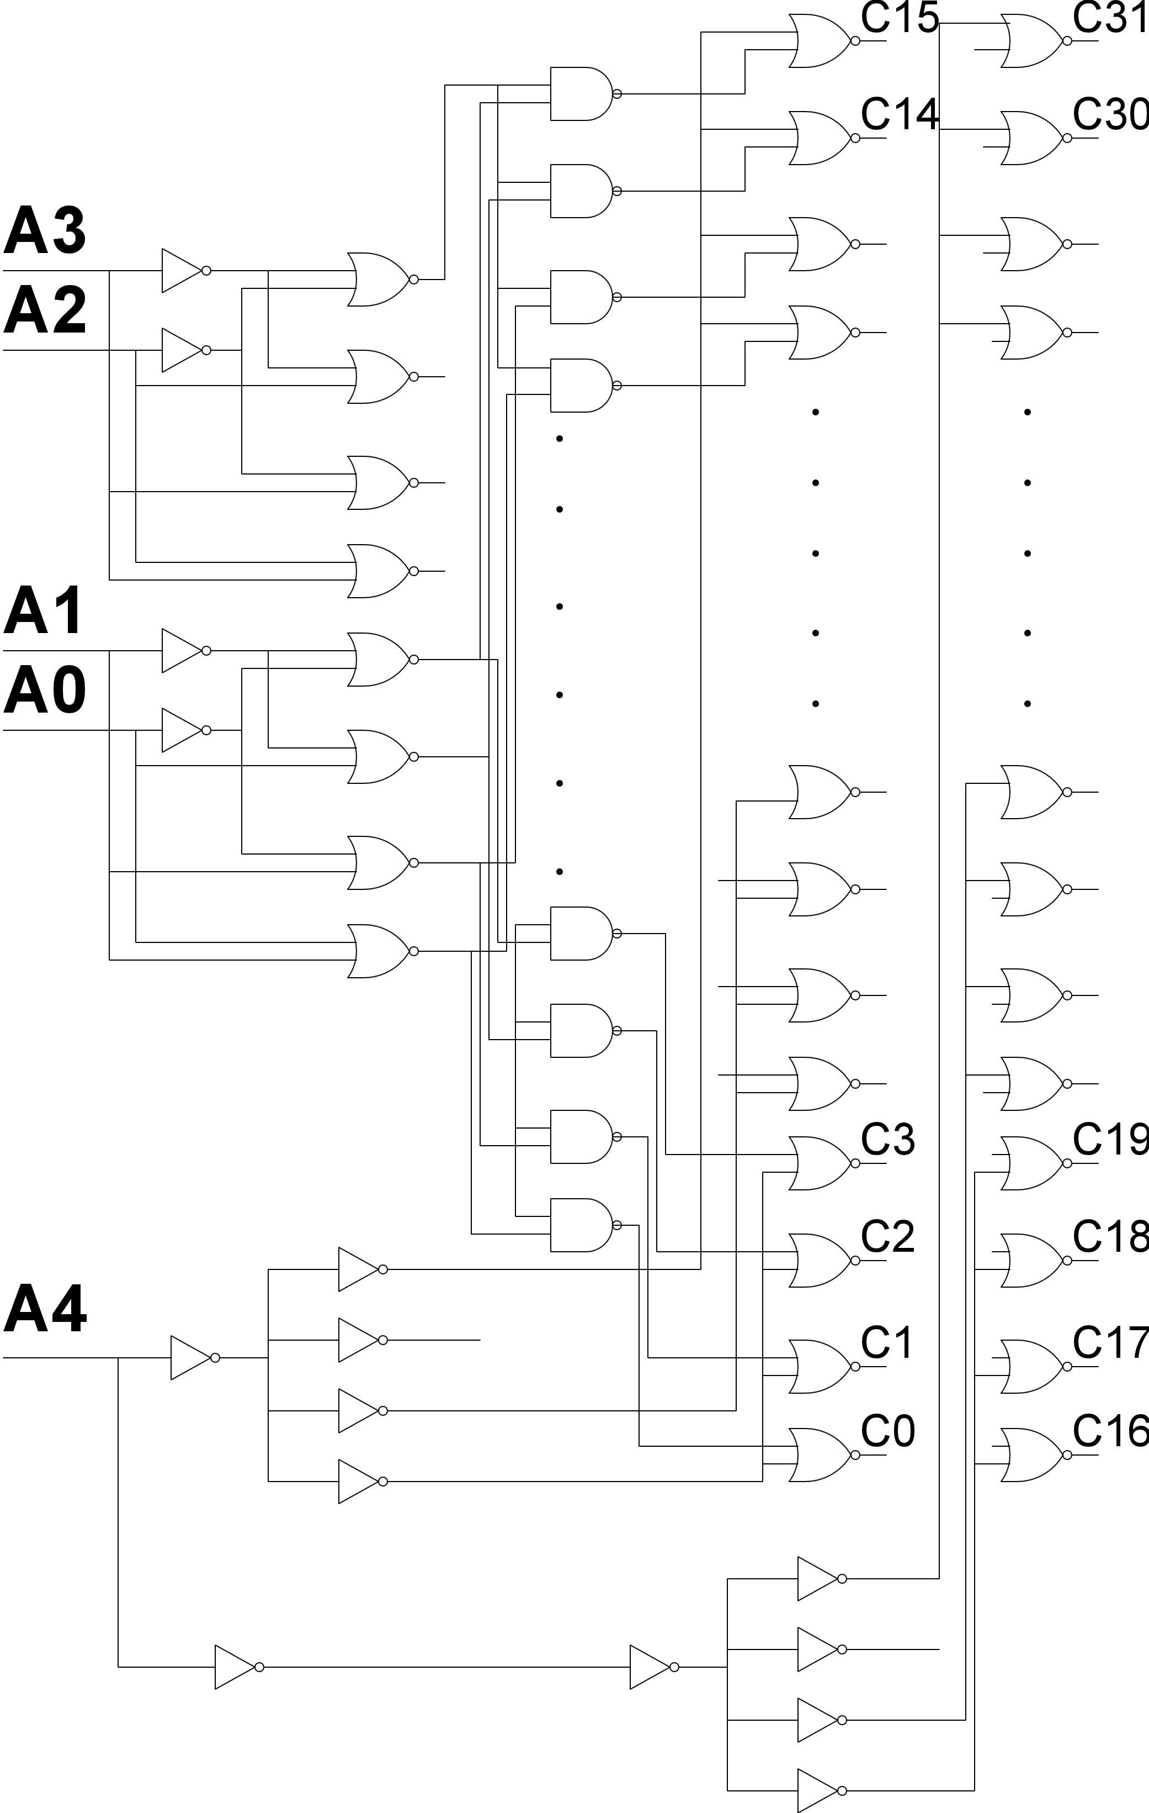
Decoder 5 X 32
Post Decoder
Stage
Pre Decoder
stage
Ref: Arvind Kumar Mishra, Debiprasad Priyabrata Acharya, Pradeep Kumar Patra “Novel Design Technique of Address Decoder for SRAM”
IEEE 2014 International Conference on Advanced Communication Control and Computing Technologies(ICACCCT)

Slide 40
Decoders Comparison
Decoder Types | Critical Path Delay (psec)
Row Decoder | 123
Column Decoder | 415
Row Decoder (Novel Technique) | 79
Column Decoder (Novel Technique) | 227

Slide 41
Sense Amplifier Design
Since our main goal is the to achieve low access time, sense amplifier should be fast.
For our access time requirement we found that full analog circuit is slow.
We implemented the sense amplifier with analog and digital mixed stage.
With which we are able to detect a 6mV difference on the bit-lines with almost an edge triggered response.

Slide 42
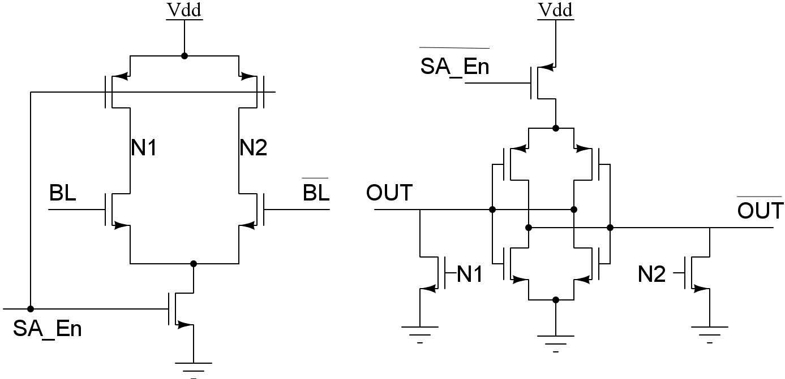
Sense Amplifier Design (cont.)
A Double-Tail Latch-Type Voltage Sense Amplifier[*]
[*] Daniel Schinkel, Eisse Mensink, Eric Klumperink, Ed van Tuijl, Bram Nauta “A Double-Tail Latch-Type Voltage Sense Amplifier with 18ps Setup + Hold Time” . 2007 IEEE International Solid-State Circuits Conference.

Slide 43
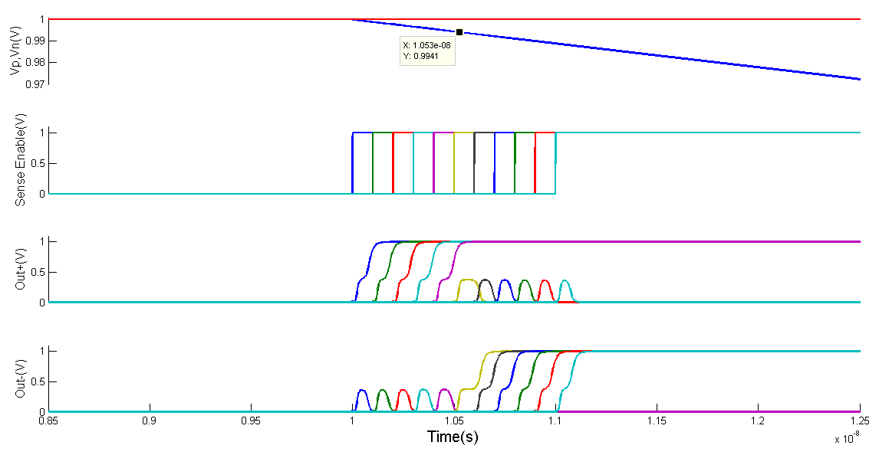
Sense Amplifier Simulation
V_{n}
V_{p}

Slide 44
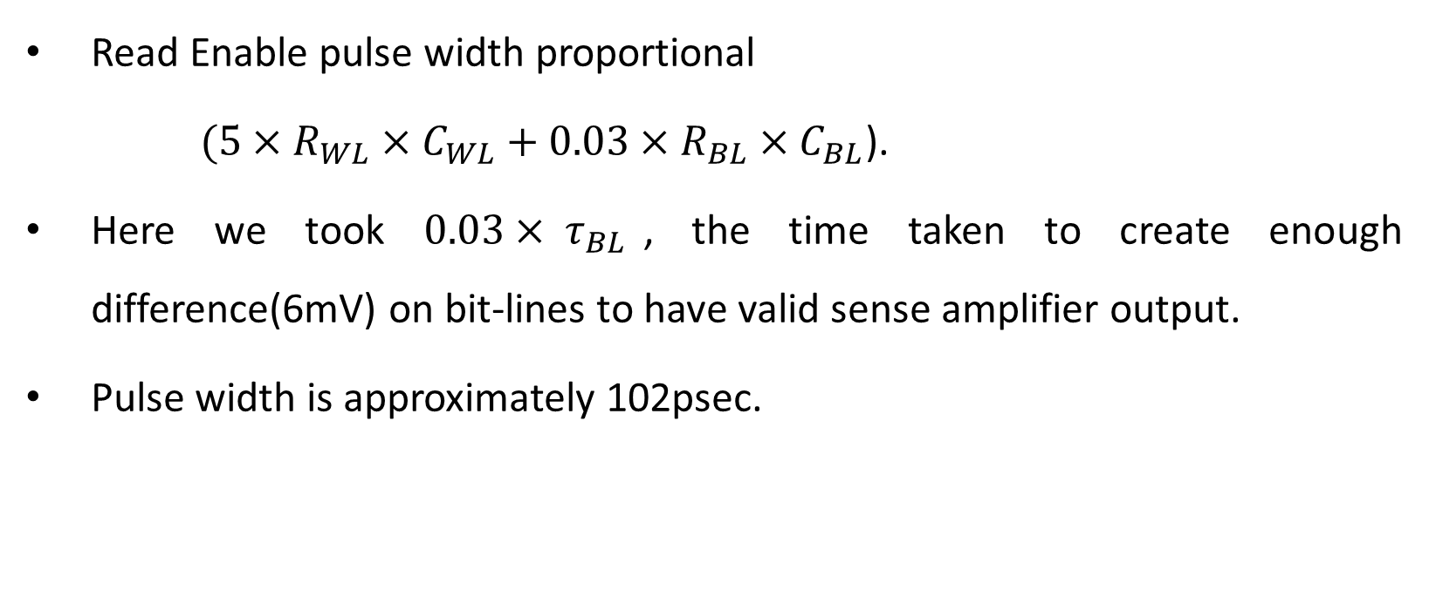
Estimation of read pulse width(Word Line pulse width)
Read Enable pulse width proportional
$(5×R_{WL}×C_{WL}+0.03×R_{BL}×C_{BL}$).
Here we took $0.03× τ_{BL}$, the time taken to create enough difference(6mV) on bit-lines to have valid sense amplifier output.
Pulse width is approximately 102psec.

Slide 45
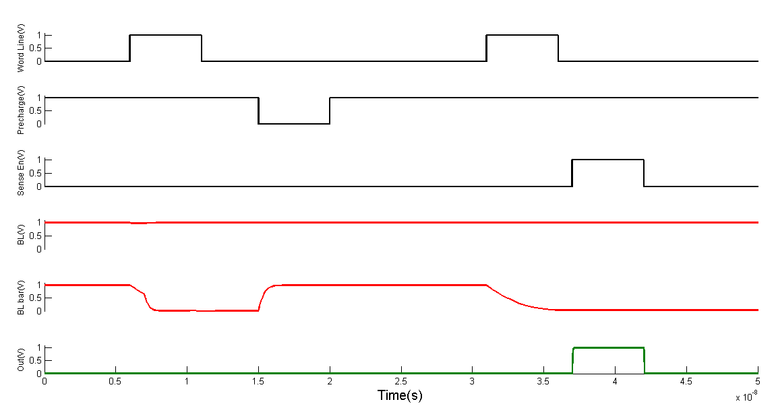
Single Memory Cell Simulation

Slide 46
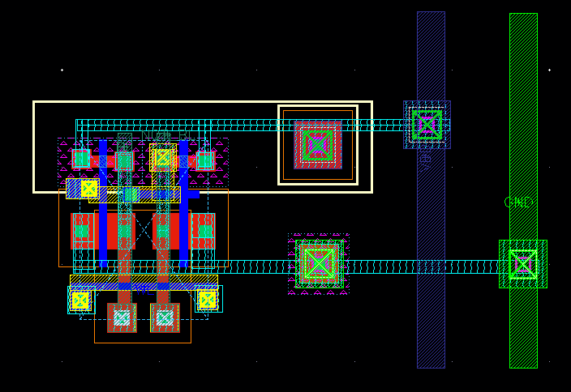
Optimized 6T Cell Layout
Parameter | Value
Length | 2.105 um
Width | 1.74 um
Area | 3.67 sq.um

Slide 47
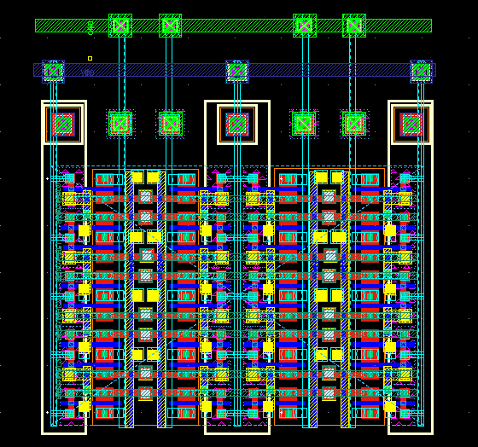
Optimized 4x4 Memory Block
Parameter | Value
Length | 7.77 um
Width | 5.54 um
Area | 43.04 sq.um
Area / cell | 2.69 sq.um

Slide 48

Bitline Twisting
Metal Layer 4 is used for twisting one of the bit lines.

Slide 49
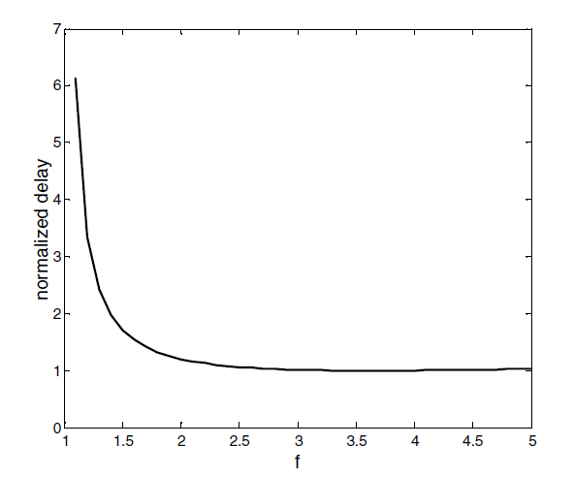
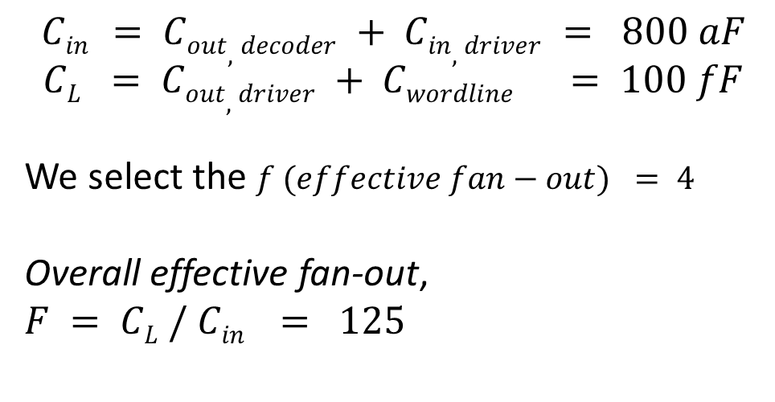
Word Line Driver
$$Cin = Cout,decoder + Cin,driver = 800 aF$$
$$CL = Cout,driver + Cwordline = 100 fF$$
We select the $f (effective fan−out) = 4$
Overall effective fan-out,
$$F = CL / Cin = 125$$
Normalized propagation delay (t_{p}/(t_{popt})) as a function of f

Slide 50
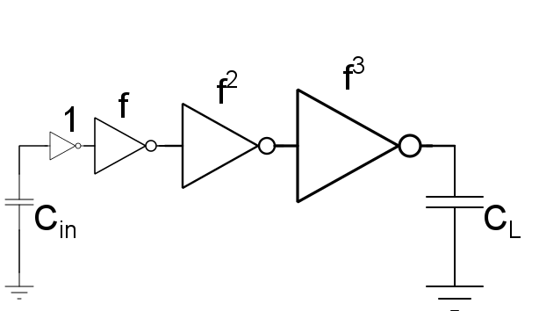
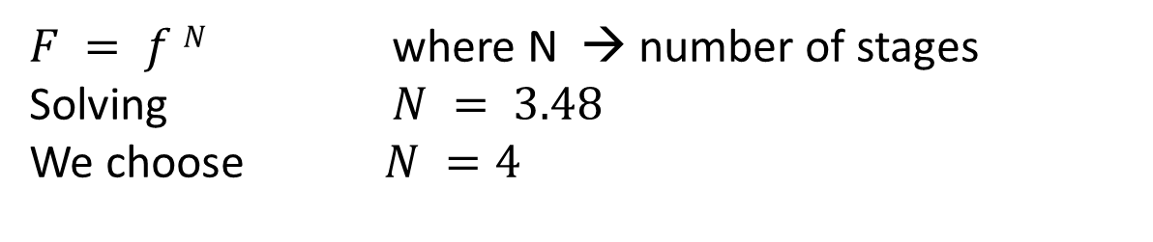
Word Line Driver
$F = f N$ where N → number of stages
Solving $N = 3.48$
We choose $N =4$

Slide 51
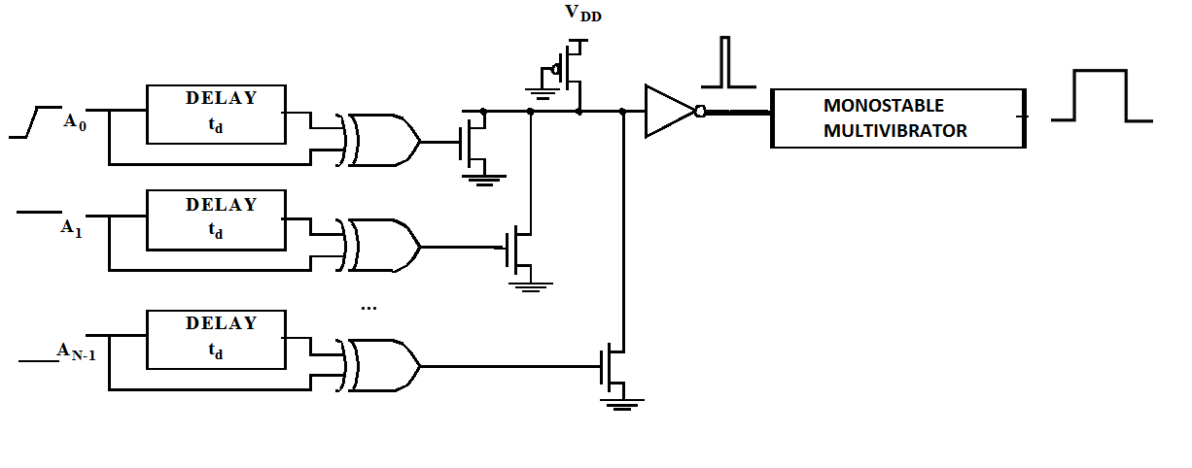
Address Transition Detector

Slide 52
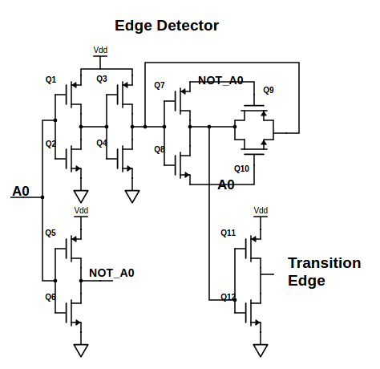

Slide 53
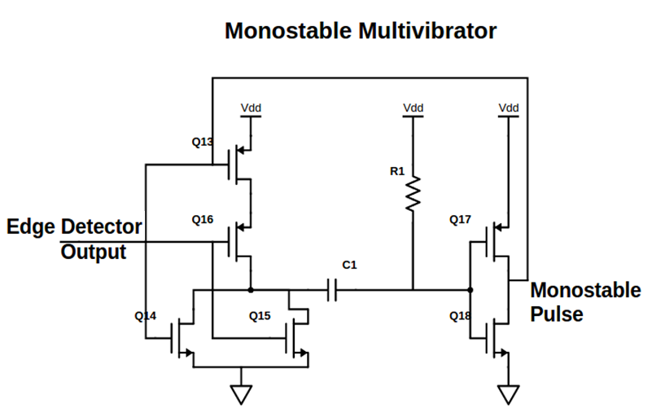

Slide 54
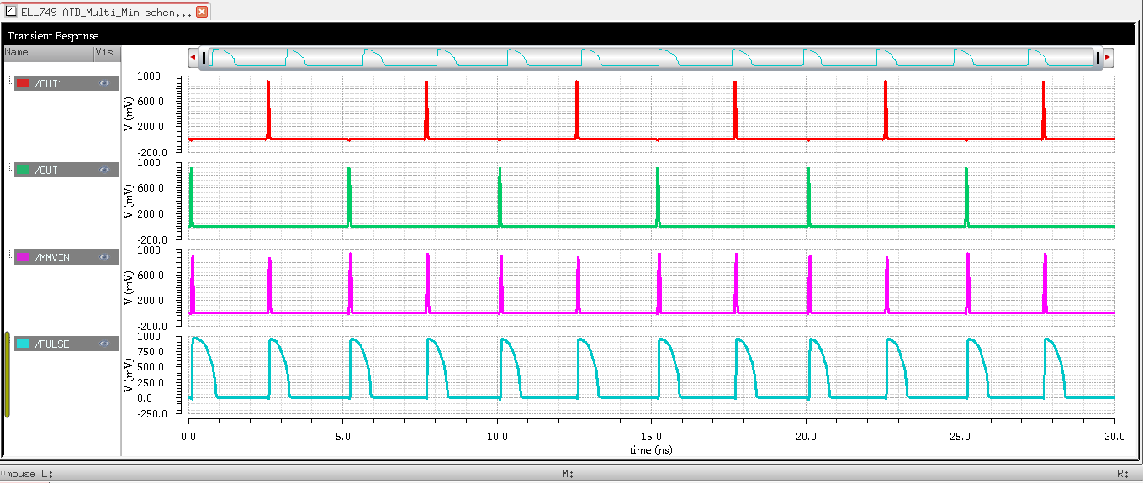
ATD Simulation

Slide 55
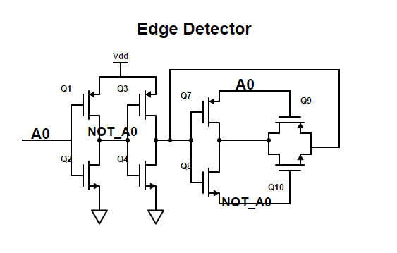
Modified Edge Detector

Slide 56
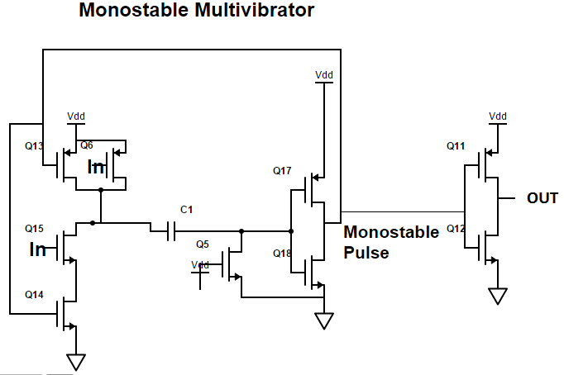
Modified Monostable Multivibrator
Corner | Pulse Width (ps)
ss | 581
tt | 531
ff | 543

Slide 57
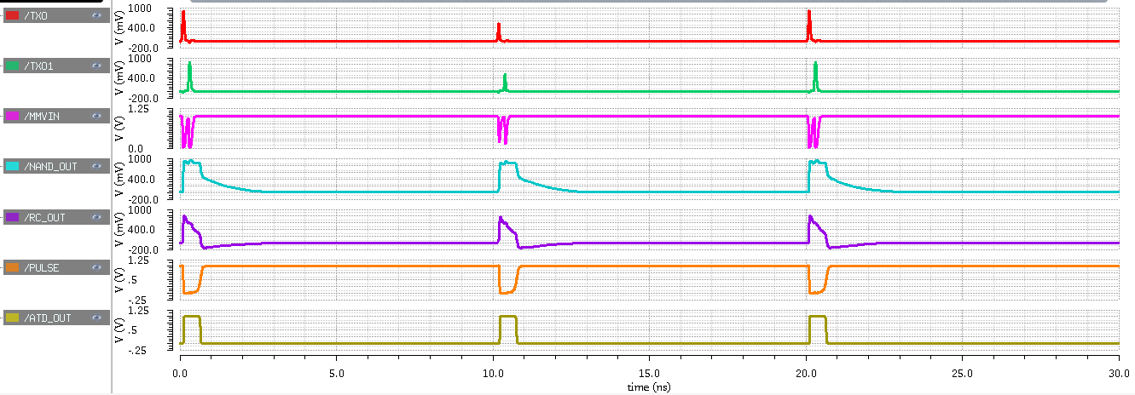
ATD Multi-Trigger Simulation

Slide 58
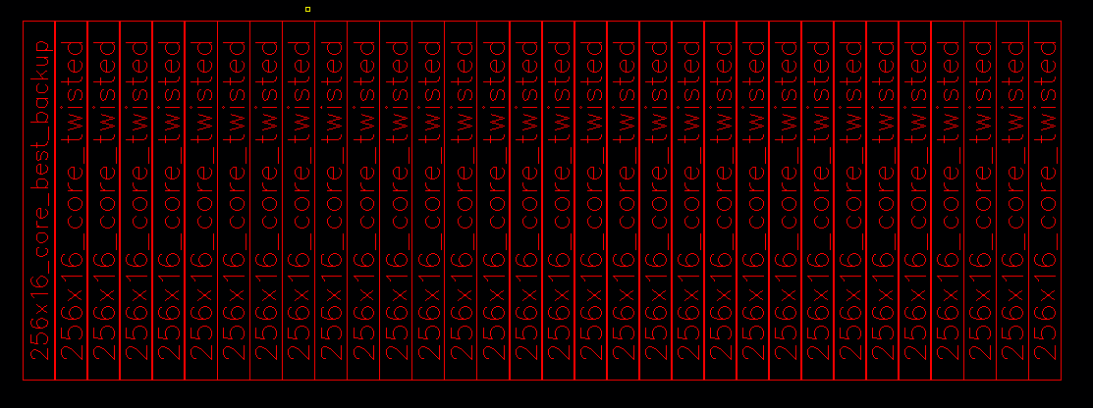
Memory Bank (256x512)

Slide 59
Memory Bank
Parameters | Values
Length | 1066 um
Width | 368 um
Area/Cell | 3 sq.um/Cell

Slide 60
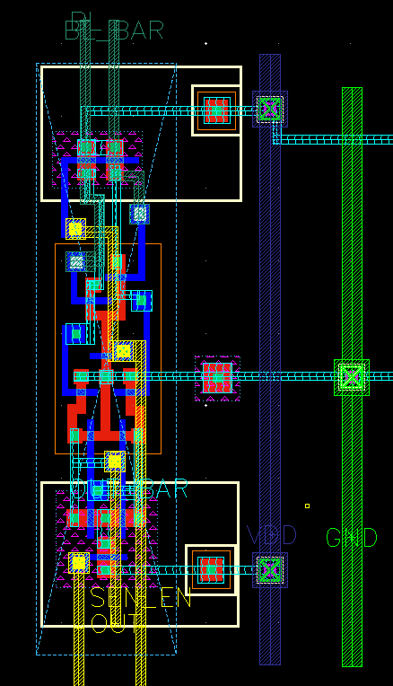
Sense Amplifier Layout

Slide 61
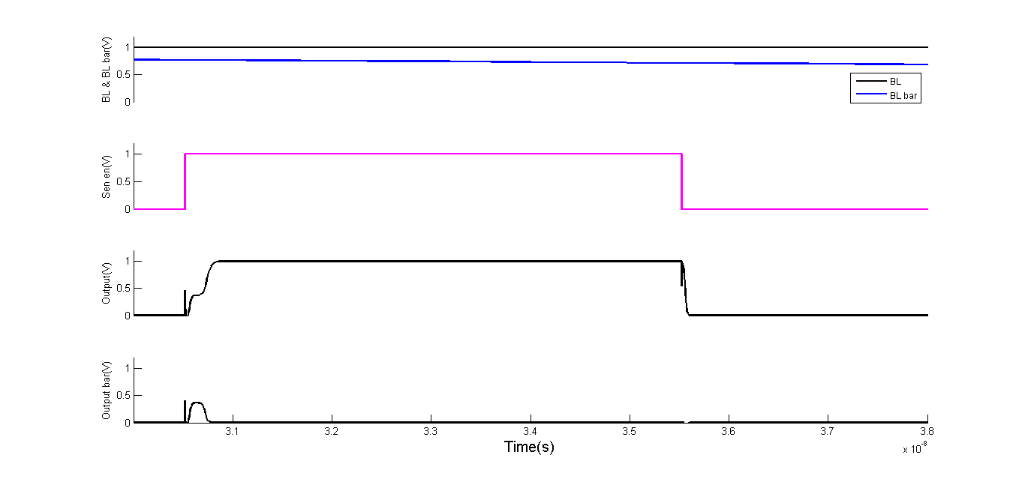
Post PEX simulation of Sense Amplifier

Slide 62
Post PEX analysis of Sense Amplifier
Parameter | Value
Sensitivity | 228 mV
Delay | 261 ps
Area | 8.06 µm² (Width = 1.47 µm )
Power (Per one SEN_EN) | 31.2 µW

Slide 63
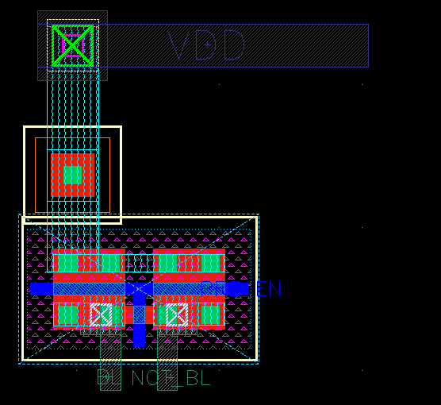
Pre-charge Circuit Layout
Parameter | Value
Length | 0.84 µm
Width | 1.38 µm
Area | 1.15 µm²

Slide 64
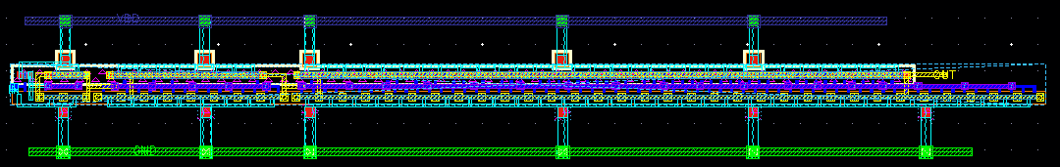
Word-Line Driver Layout
Parameter | Value
Length | 1.725 µm
Width | 38.86 µm
Area | 67.03 µm²

Slide 65
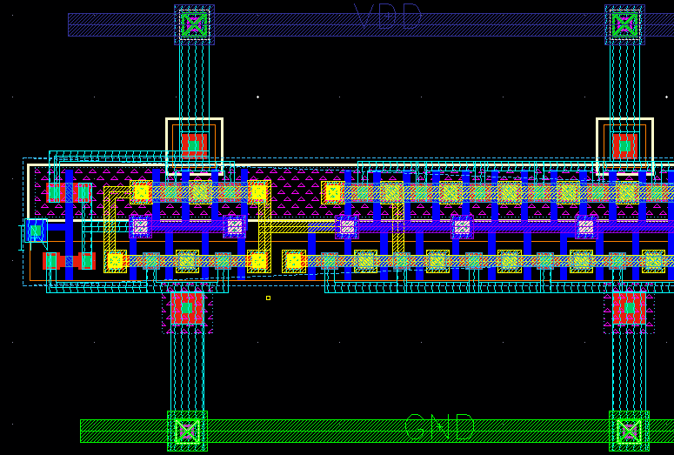
Word-Line Driver Layout (Enlarged)

Slide 66

Post PEX simulation of Word Line Driver
Parameter | Value
Delay (90% of VDD) | 183.57 ps

Slide 67

Write Buffer Schematic

Slide 68

Row Pre-Decoder Layout

Slide 69

Column Pre-Decoder Layout

Slide 70

Column Decoder(Final Stage) Layout

Slide 71

Block Decoder Layout

Slide 72
Decoder Dimensions
Instance | Area ( µm² )
Row Pre-Decoder | 220.56
Column Pre-Decoder | 126.46
Column Final-Stage | 293.03
Block Decoder | 39.21

Slide 73

ATD – Edge Detector

Slide 74

ATD – Wired OR

Slide 75

ATD – Monostable Multivibrator

Slide 76


Integrated Memory Bank
(512 $×$256 bits)
Parameter | Value
Width | 408.185 µm
Length | 1075.925 µm
Area (per bank) | 0.439 mm²

Slide 77

Sense Amplifier – Core Interface

Slide 78

Pre Charge – Core Interface

Slide 79

Word-Line Driver – Core Interface

